Slide 1
DESIGN OF
INDUSTRIAL ROBOT
VEERA VENKATA SAI MAHESH REDDI
DEREK WOLF

Slide 2
OUTLINE
ABSTRACT
INTRODUCTION
COMPONENTS
DEGREES OF FREEDOM
WORK ENVELOPE
DESIGN
APPLICATIONS
LIMITATIONS
CONCLUSION

Slide 3
ABSTRACT
In the era of industrialization, industrial robots plays an important role in Manufacturing sector. Therefore, current situation, and emerging technologies in industrial robotics are covered in this talk.
This talk also covers the development of new technologies, such as human voice control robots used in the oil and gas and automotive industries.
On the one hand, there is rapid technological advancement, while on the other hand, there is an impact on human labor.

Slide 4
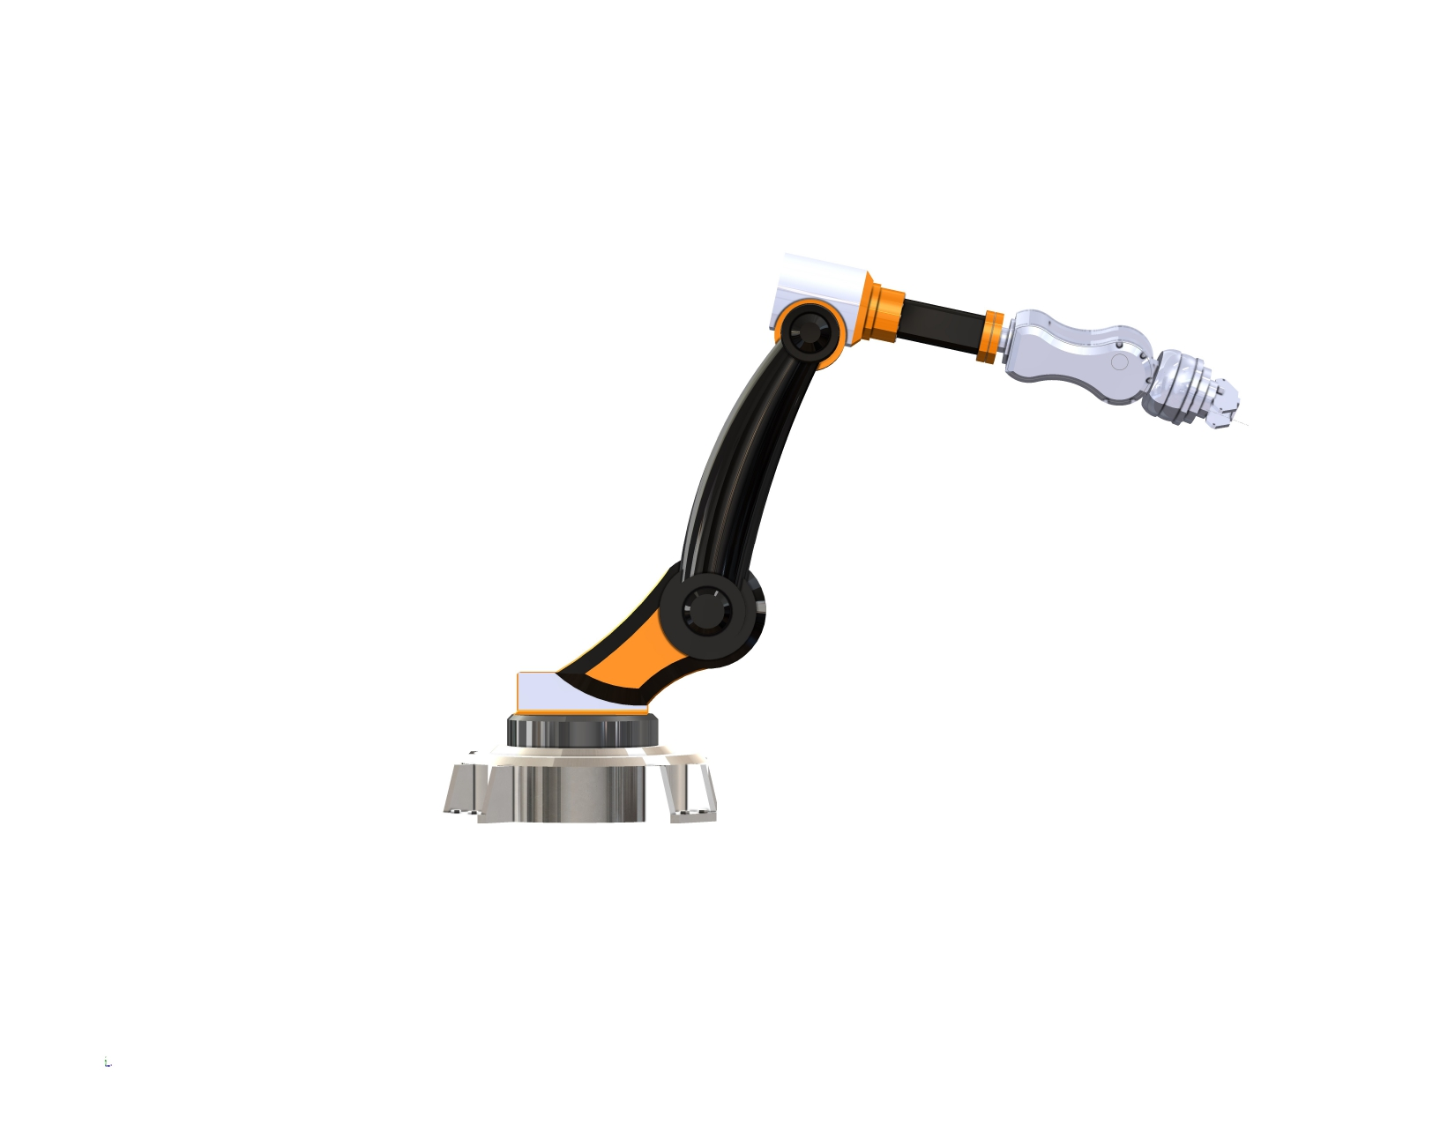
INTRODUCTION
Today, we embark on a journey into the heart of technological innovation, where precision meets efficiency and automation transforms industries.
Industrial Robots are the vanguards of advancement in a quickly changing world where the needs of modern production and manufacturing are always changing. They are more than simply machines; they are the designers of a new era, altering how we build, manufacture, and invent.

Slide 5
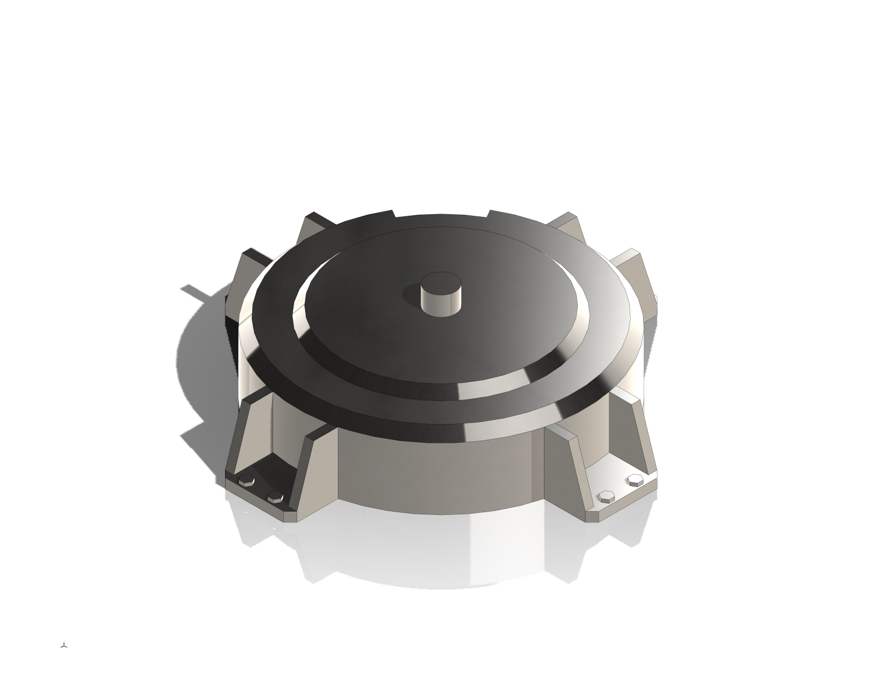
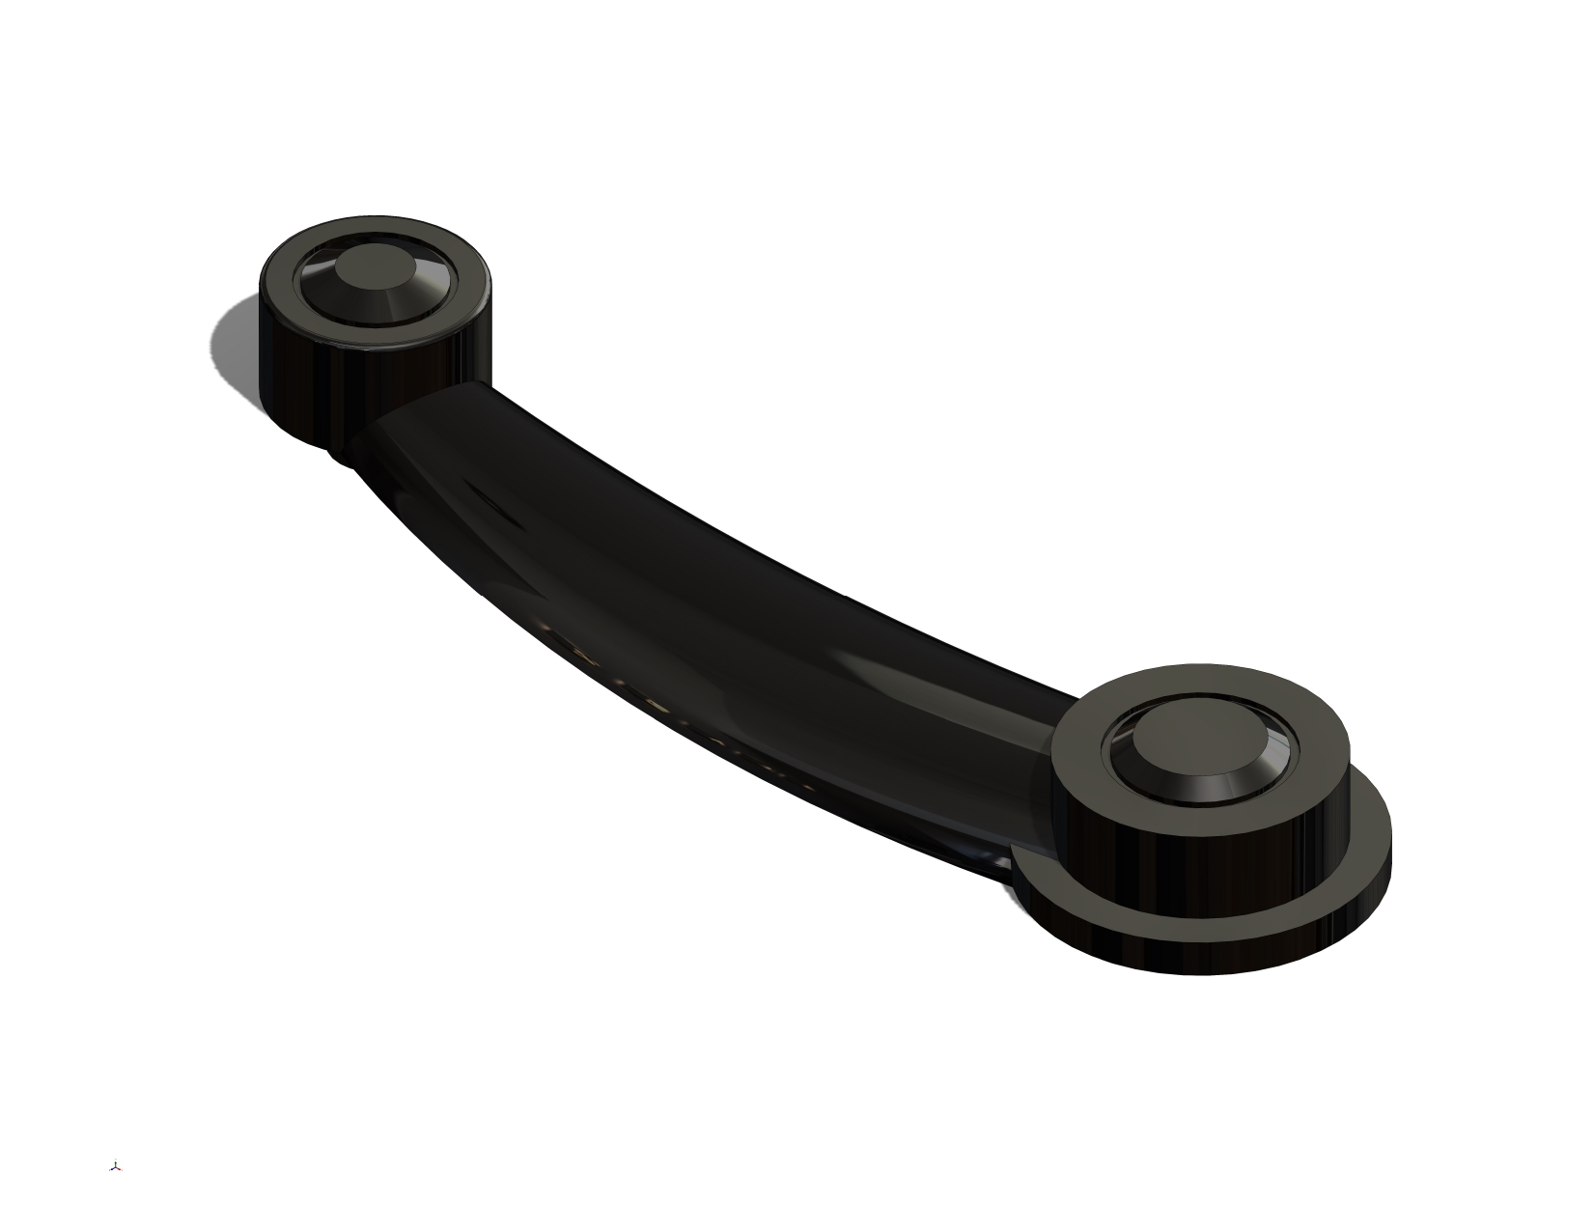
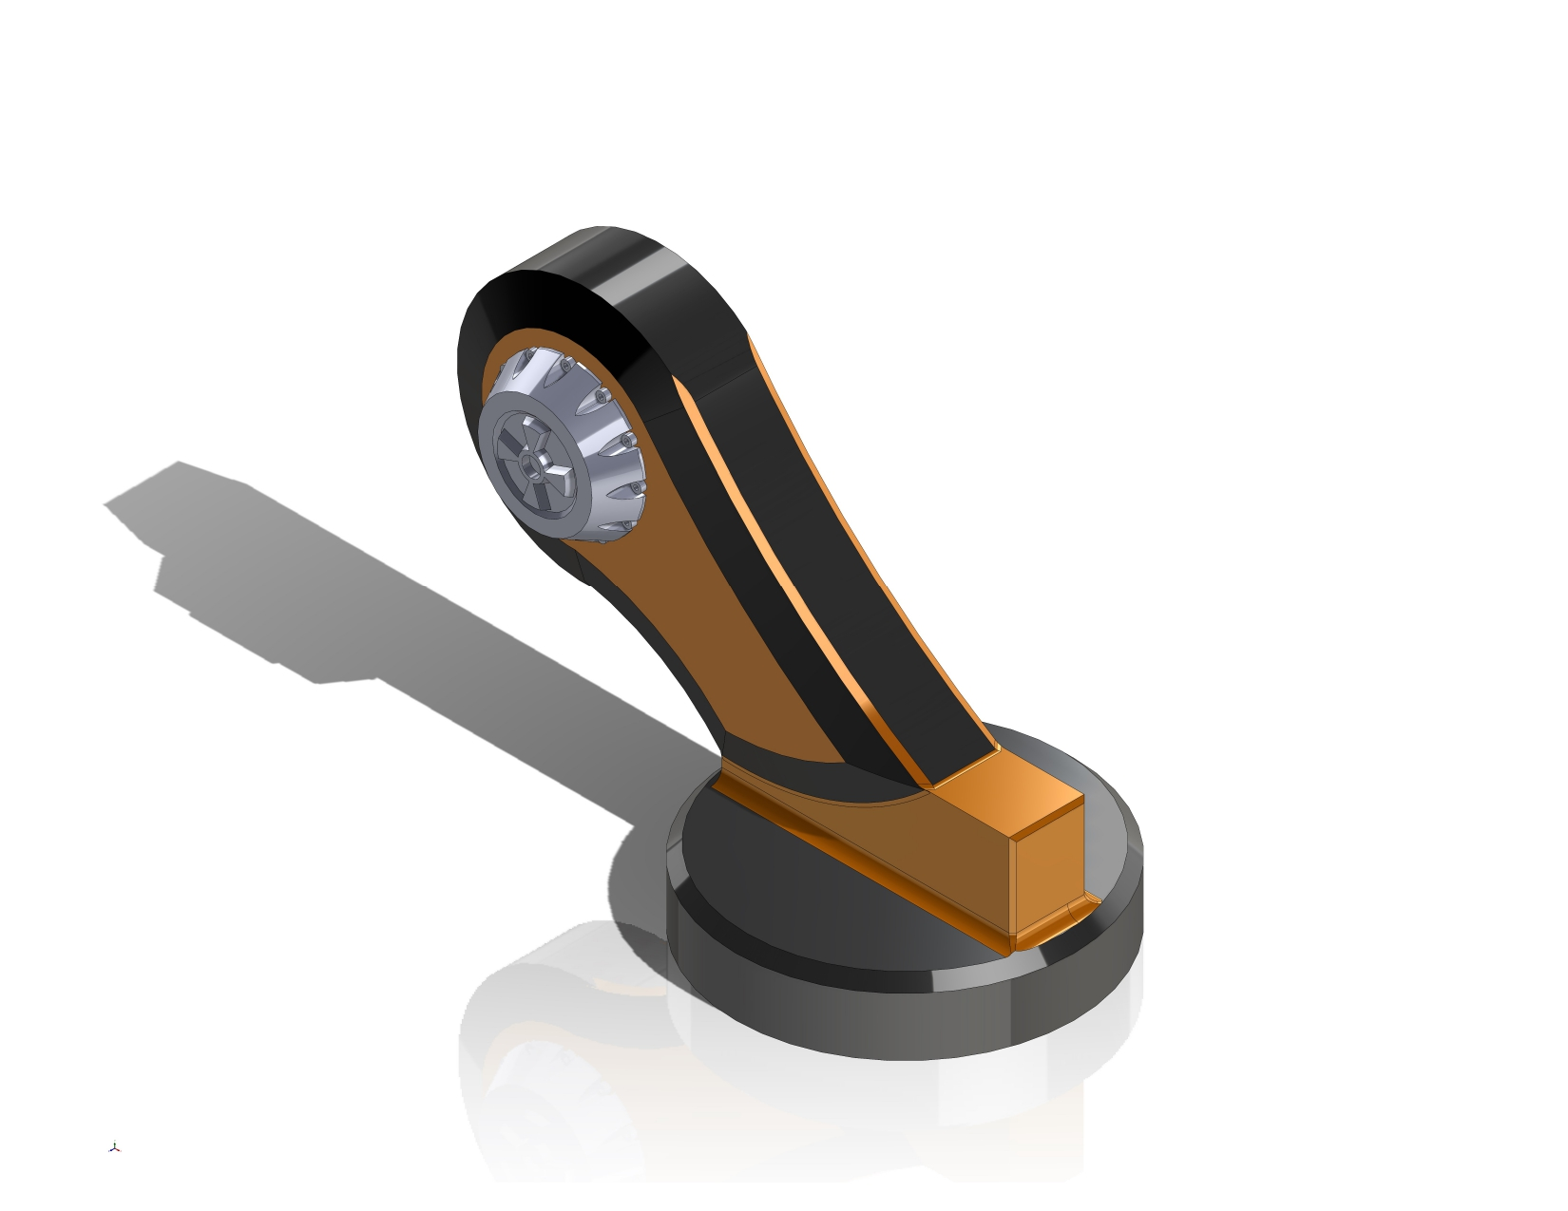
MAIN COMPONENTS OF AN
INDUSTRIAL ROBOT SYSTEM
FIXED BASE
CONNECTING ROD
SPHERICAL LINK

Slide 6
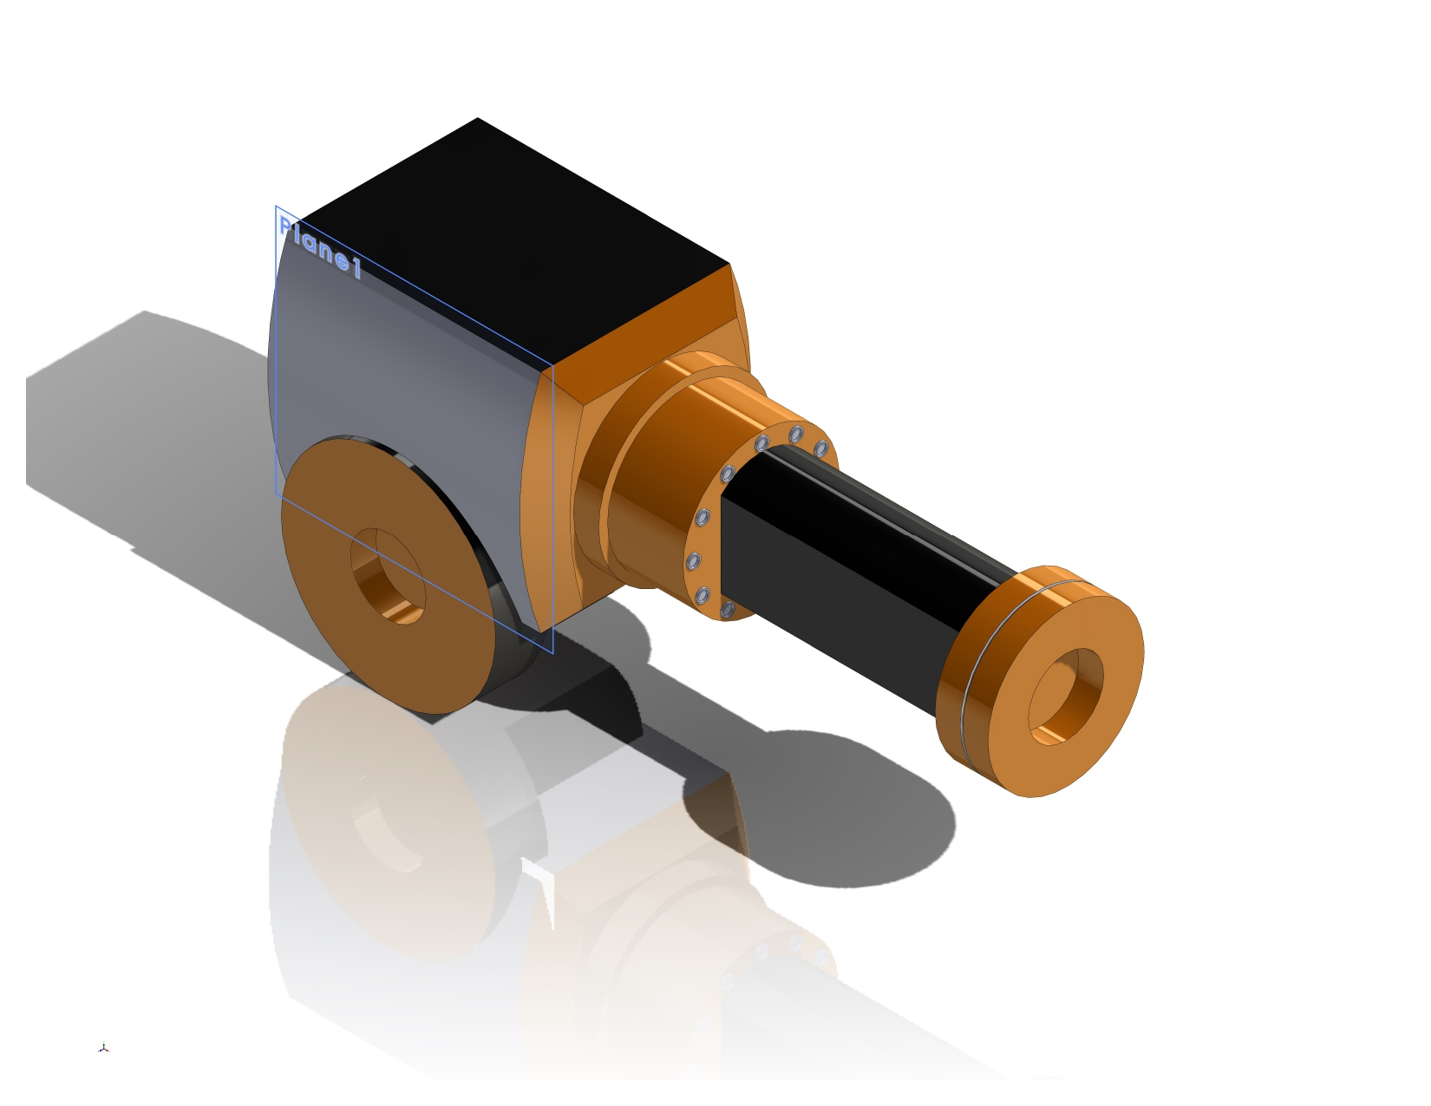
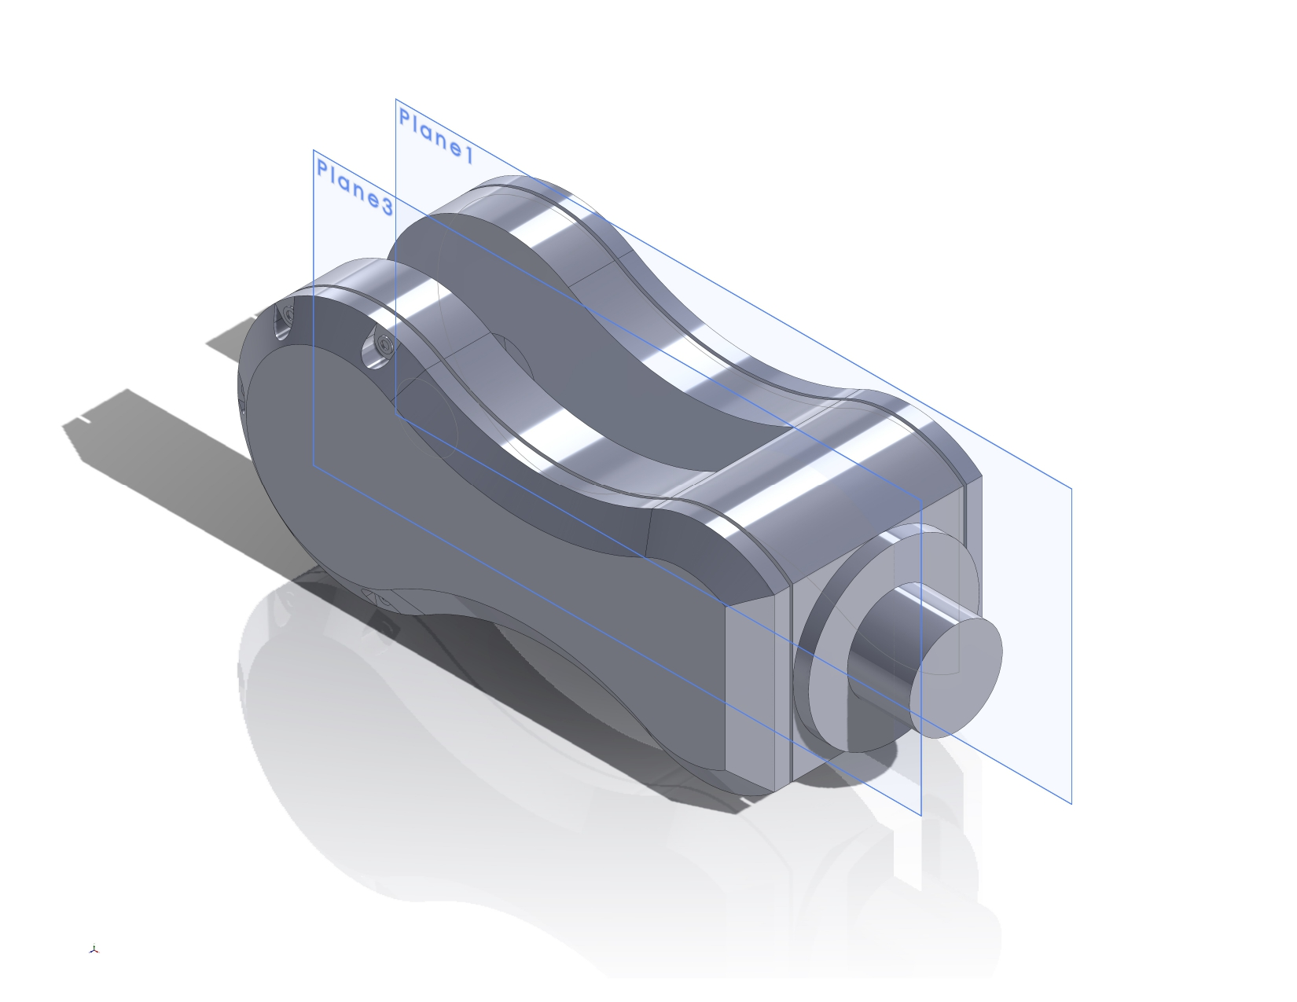
COMPONENTS
REVOLUTE LINK
ARM

Slide 7
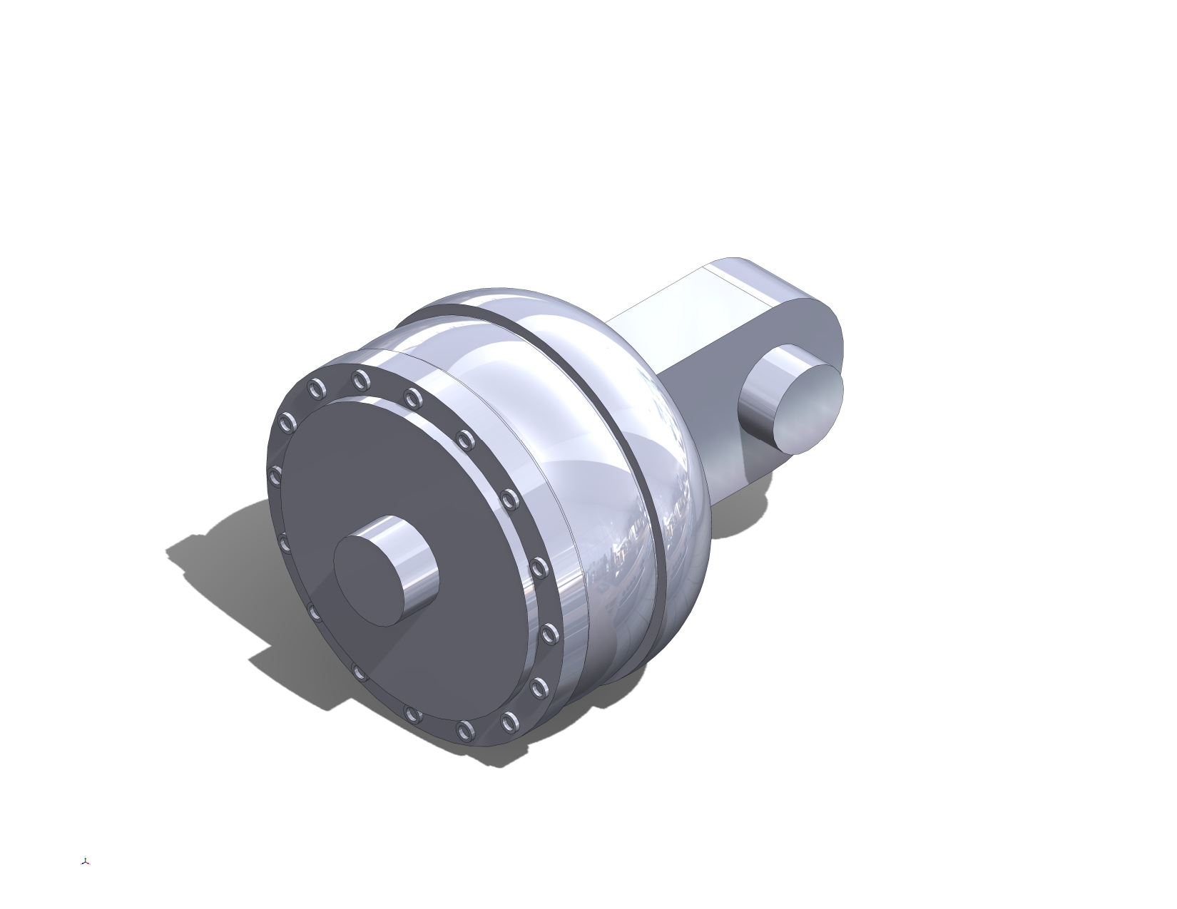
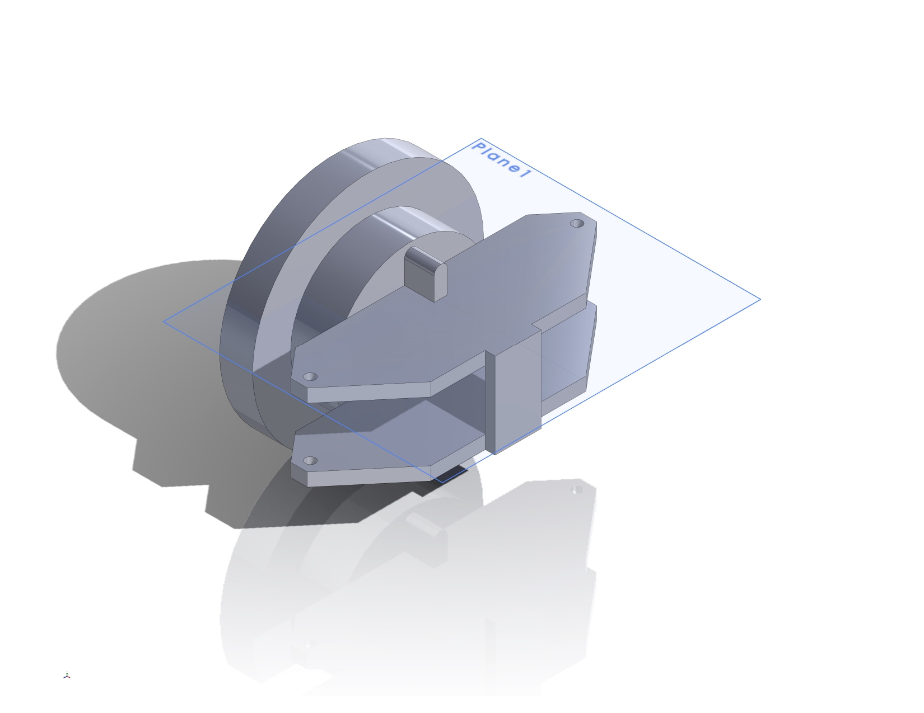
COMPONENTS
WRIST

Slide 8
DEGREES OF FREEDOM
DOF : The number of independent parameters or ways a mechanical system can move without violating any constraints.
For a Articulated Robot, the number of degrees of freedom is 6.
The number of degrees of freedom may change, based on the type of End effector which we used as per requirement.
And the designed robot has 8 links including ground and 6 joints.
The robot has 3 revolute joints and 3 spherical joints.
Based on this info, we can calculate the number of degrees of freedom using Grubler’s Formula.

Slide 9
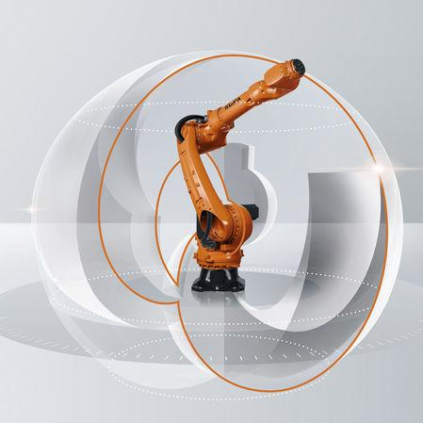
WORK ENVELOPE
A robot's work envelope is the three-dimensional area or place that it may operate in and carry out its duties.
The robot's freedom of movement within its work envelope may be impacted by obstructions or other equipment present in the workplace. Potential interference should be taken into account during design.
The furthest an articulated robot can extend its end-effector (tool or gripper) from its base is known as its reach. This establishes the spherical or cylindrical work envelope's radius.

Slide 10
DESIGN
We have designed the robot using Solidworks software.
Solidworks is a 3D modelling software used to design a product by various tools.
The robot is designed by using various commands/tools like.
Sketch
Line
Circle
Fillet
Chamfer
Swept boss
Dimension
Arc
Tangent
Extrude
Extrude Cut
Rectangle
Mirror
Array
Offset
Assembly
Mate

Slide 11
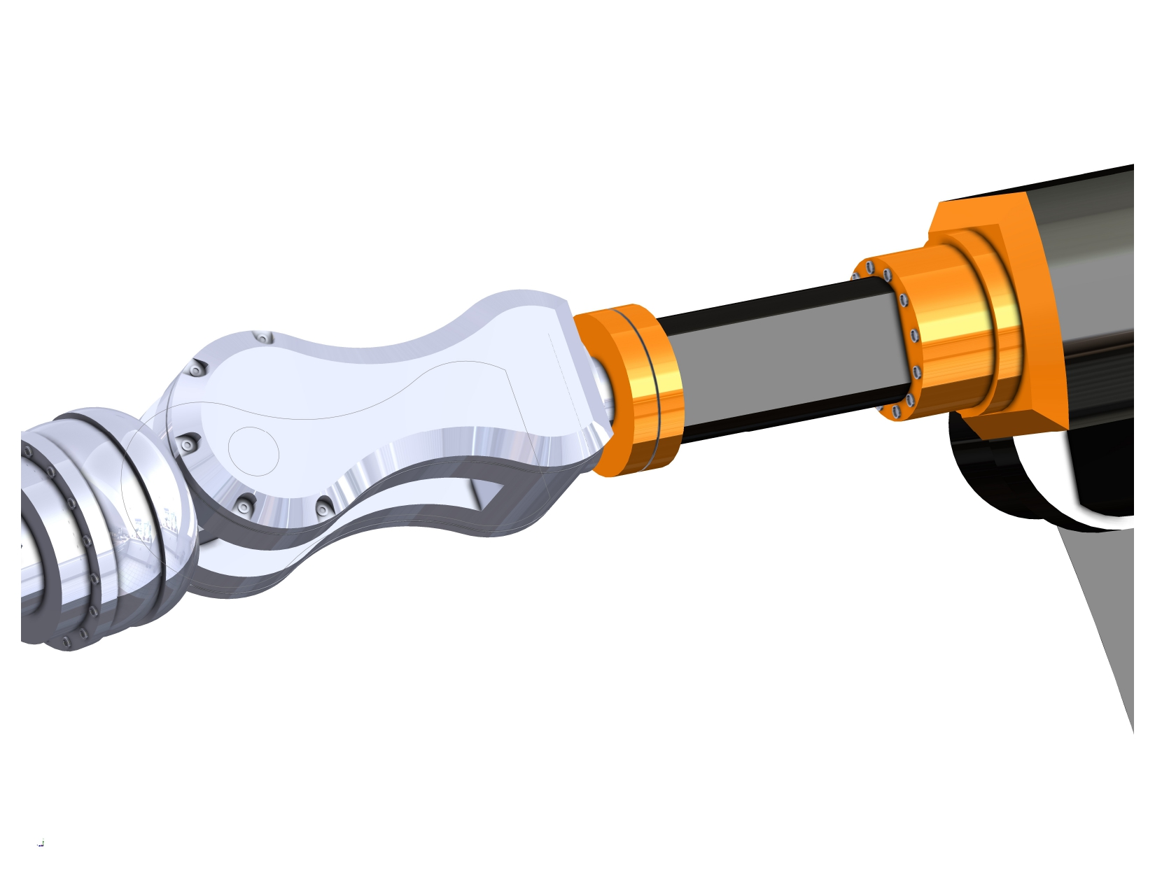
DESIGN

Slide 12
DESIGN

Slide 13
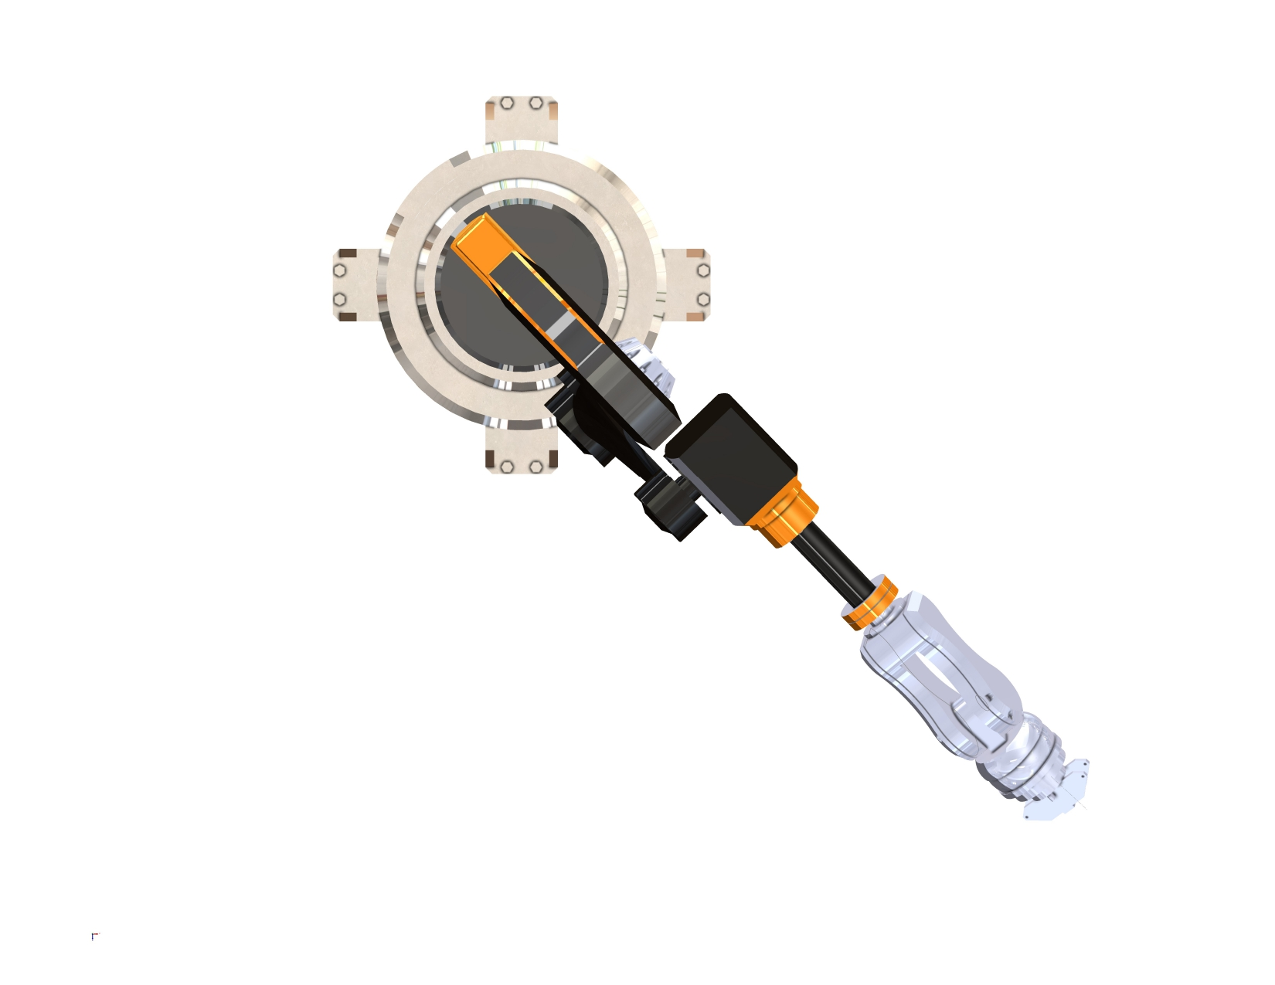
DESIGN

Slide 14
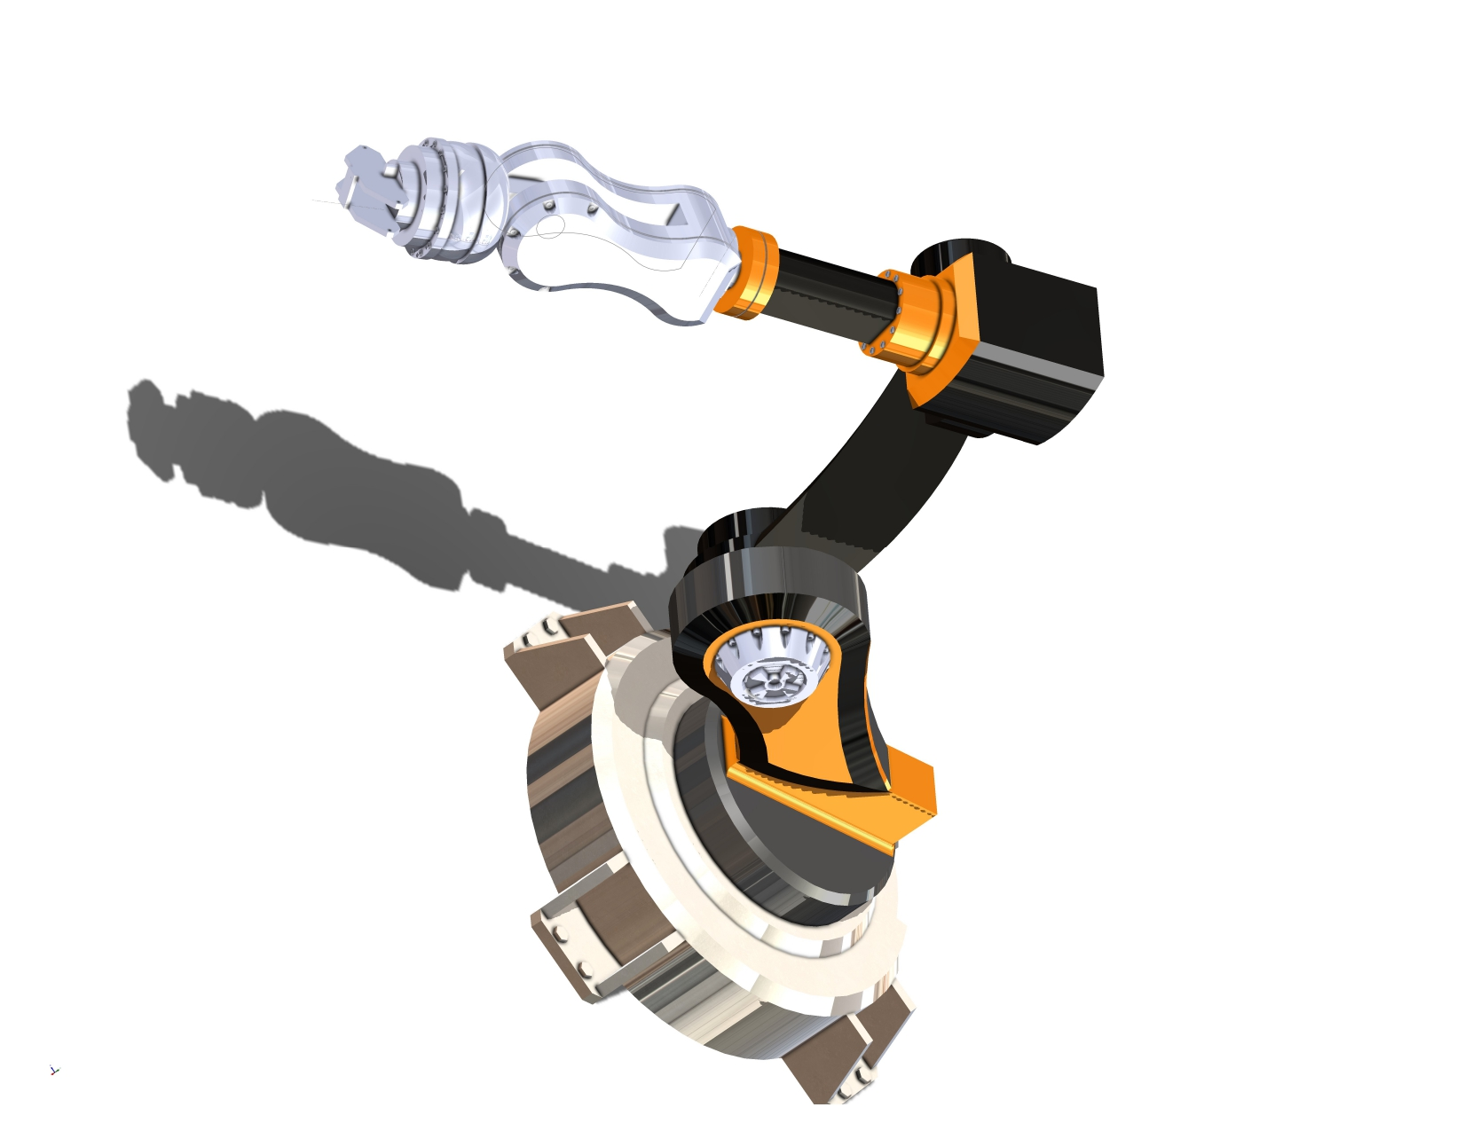
DESIGN

Slide 15
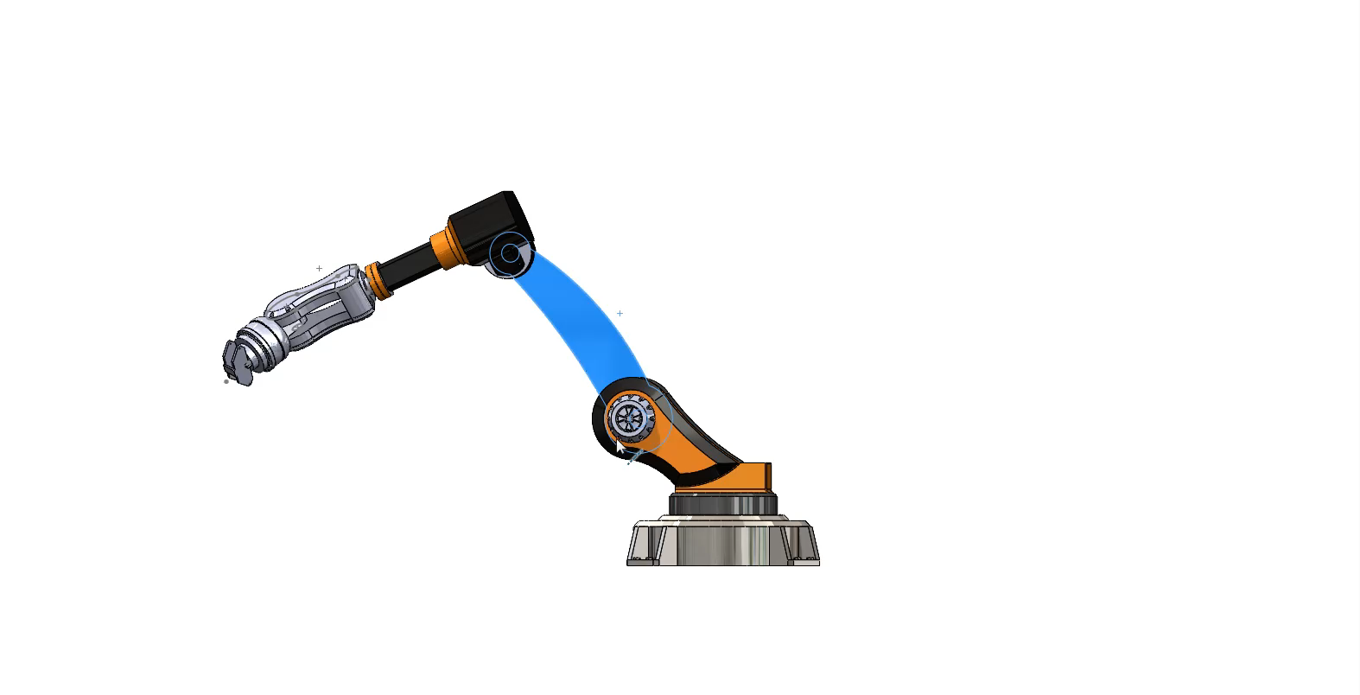
WORKING OF ROBOT

Slide 16
APPLICATION
In the production of automobiles, articulated robots are frequently utilized for jobs including welding, painting, and assembling. They work in the handling of fragile components, circuit board assembly, and electronic component assembly.
Articulated robots are used for picking, putting, and palletizing goods in warehouses. And also used in precision and repeatable welding and cutting operations in sectors like shipbuilding and metal production.
They are used to precisely paint and cover surfaces in sectors like as aerospace and automotive. In medical surgery, articulated robots are employed for precise jobs including minimally invasive procedures.
Robotic arms with articulated movements are used in additive manufacturing processes in some applications of 3D printing.

Slide 17
LIMITATIONS
The range of motion of articulated robots is dictated by the space between their joints. This restriction may make it more difficult for them to handle big or oddly shaped objects.
The cost of buying, installing, and maintaining it might be high. Applications with a tight budget or smaller enterprises may find the first cost prohibitive.
Despite these drawbacks, continued research and technological developments in the field of robotics are intended to overcome these obstacles and improve the capabilities of articulated robots across a range of industries. When choosing a robot for a particular application, it's critical to take these restrictions into account and to put the right safety precautions in place to guarantee their safe functioning.

Slide 18
CONCLUSION
In summary, the mechanical structure of the articulated robot has been successfully shaped by the SolidWorks-based design phase. Using SolidWorks for 3D modeling guaranteed accurate representations and allowed for a thorough visualization of the components. Achieving the intended range of motion through careful joint configuration adjustments was given top priority during the design process. The cooperative methodology employed by teams enabled smooth incorporation of mechanical elements, thereby augmenting the articulated robot design's overall efficency and accuracy.

